Slide 1
Virtual Experiments and Differential Equations Models Chris McCarthy
Borough of Manhattan Community College City University of New York
2019 Joint Mathematics Meetings Baltimore
January 19, 2019

Slide 2
Virtual experiments and Differential Equations
Computer simulations,
or
videos or photos of an actual physical experiment,
from which data can be culled
and
which can be modeled using differential equations.
Virtual Experiments Chris McCarthy cmccarthy@bmcc.cuny.edu

Slide 3
Why teach modeling in a Diff Eq class?
Most of my students are interested in applications, engineering, and science.
Modeling gives math physical meaning.
Joy of Discovery. Enthusiasm. Creative Thinking. Fun.
Virtual Experiments Chris McCarthy cmccarthy@bmcc.cuny.edu

Slide 4
Why Virtual Experiments?
Quicker than real experiments.
Not messy. No lab needed.
Makes the modeling even more real. More thinking.
Students learn about data analysis and parameter estimation in the context of diff eq models.
Virtual Experiments Chris McCarthy cmccarthy@bmcc.cuny.edu

Slide 5
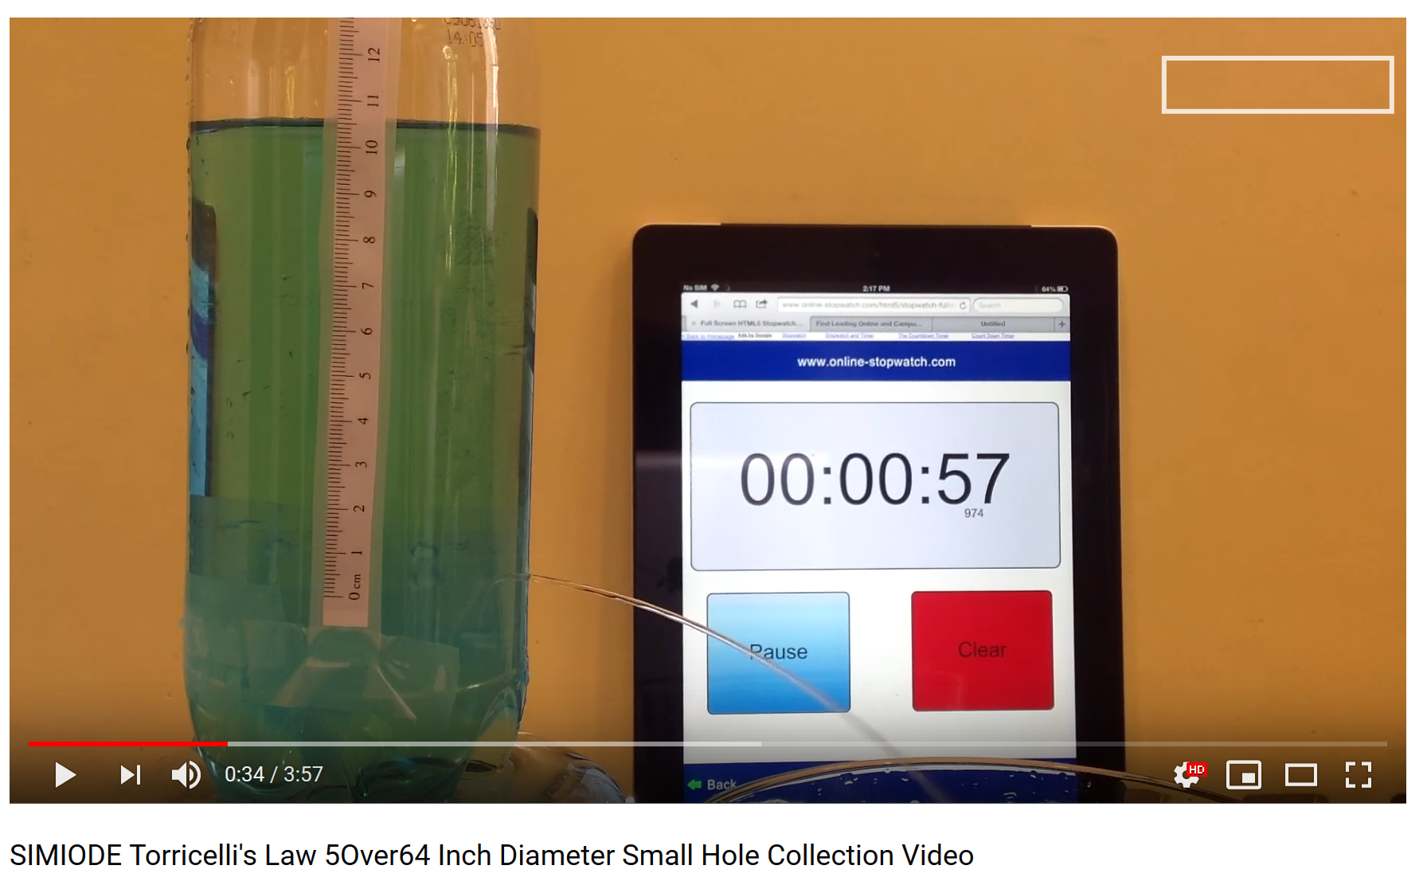
Sources for Virtual Experiments WWW.SIMIODE.ORG
Brian Winkel (2017), 1-073-S-Water Exit Bottle, https://www.simiode.org/resources/3507
(Torricelli's Law)
Virtual Experiments Chris McCarthy cmccarthy@bmcc.cuny.edu

Slide 6
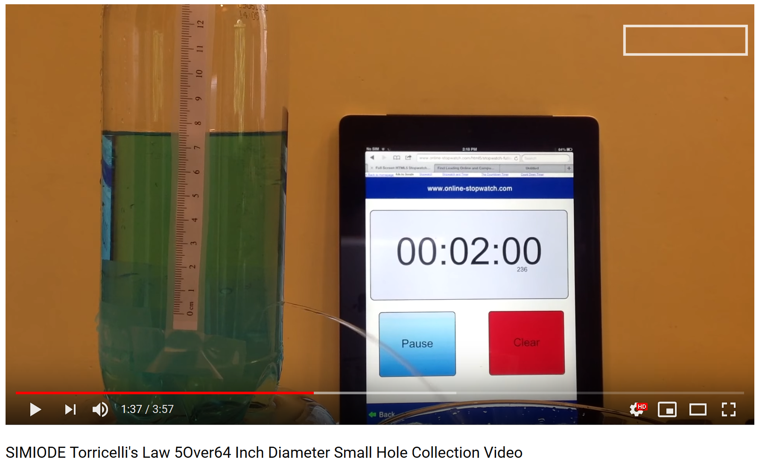
Sources for Virtual Experiments WWW.SIMIODE.ORG
Brian Winkel (2017), 1-073-S-Water Exit Bottle, https://www.simiode.org/resources/3507
(Torricelli's Law)
Virtual Experiments Chris McCarthy cmccarthy@bmcc.cuny.edu

Slide 7
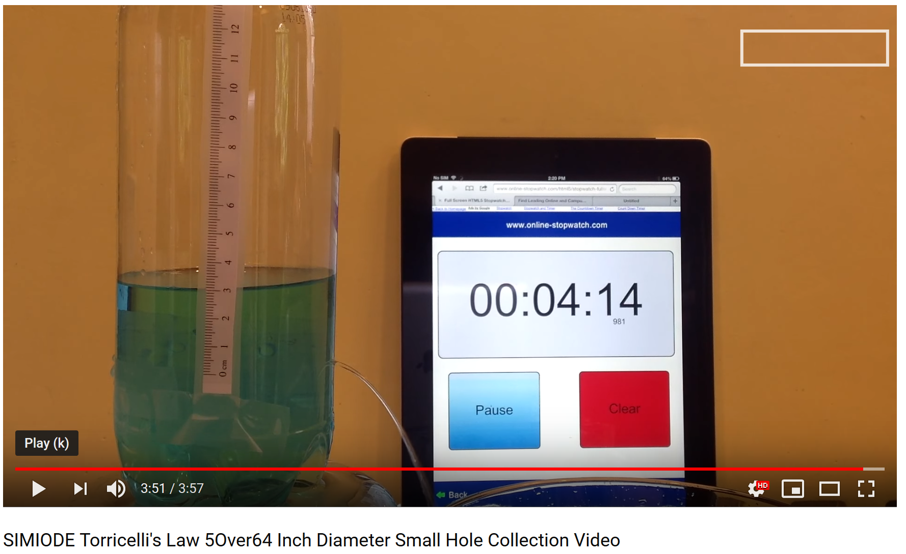
Sources for Virtual Experiments WWW.SIMIODE.ORG
Brian Winkel (2017), 1-073-S-Water Exit Bottle, https://www.simiode.org/resources/3507
(Torricelli's Law)
Virtual Experiments Chris McCarthy cmccarthy@bmcc.cuny.edu

Slide 8
Sources for Virtual Experiments University of Reading (England)
Virtual Experiments Chris McCarthy cmccarthy@bmcc.cuny.edu

Slide 9
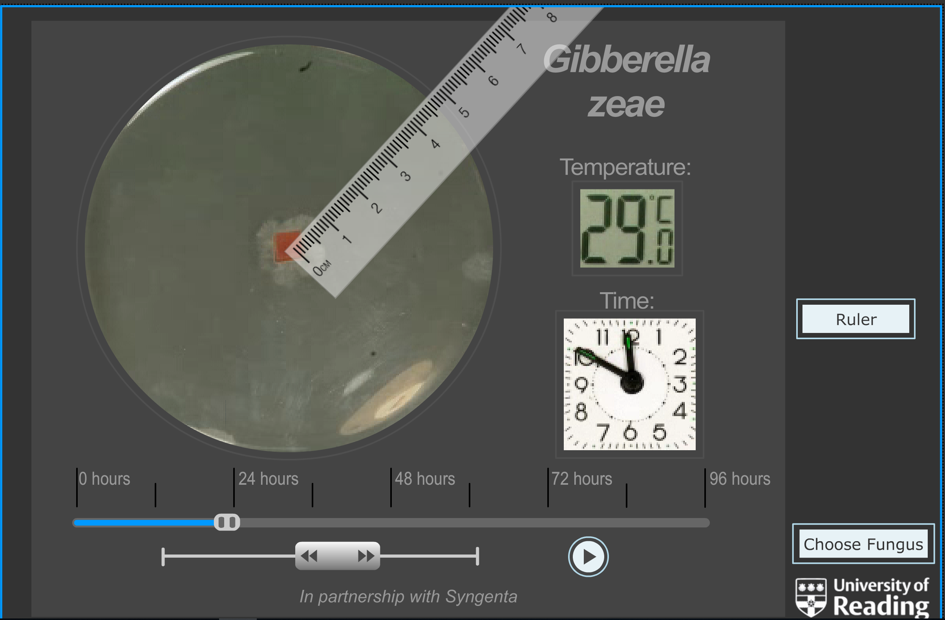
Sources for Virtual Experiments University of Reading (England)
Virtual Experiment:
Fungus growth.
U of Reading, UK.
Virtual Experiments Chris McCarthy cmccarthy@bmcc.cuny.edu

Slide 10
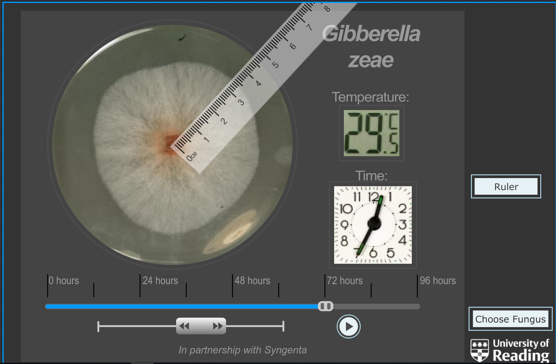
Sources for Virtual Experiments University of Reading (England)
Virtual Experiment:
Fungus growth.
U of Reading, UK.
Virtual Experiments Chris McCarthy cmccarthy@bmcc.cuny.edu

Slide 11
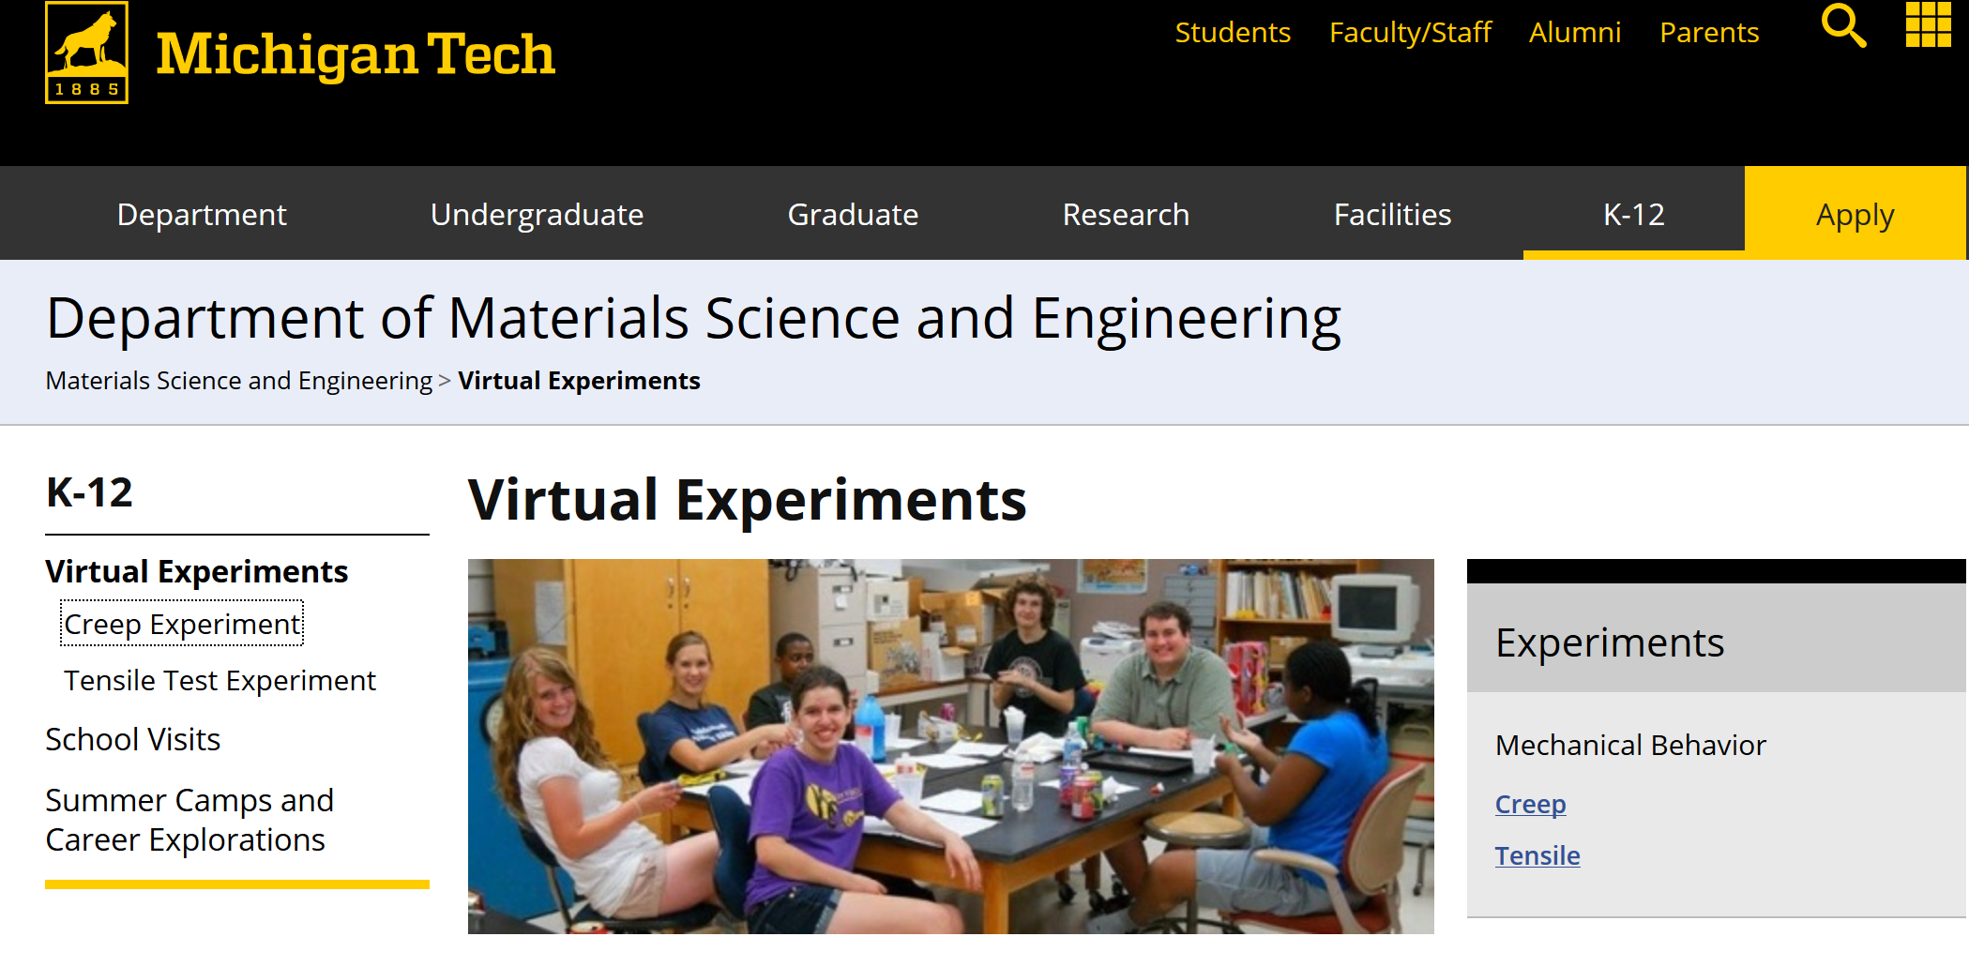
Sources for Virtual Experiments
Virtual Experiments Chris McCarthy cmccarthy@bmcc.cuny.edu

Slide 12
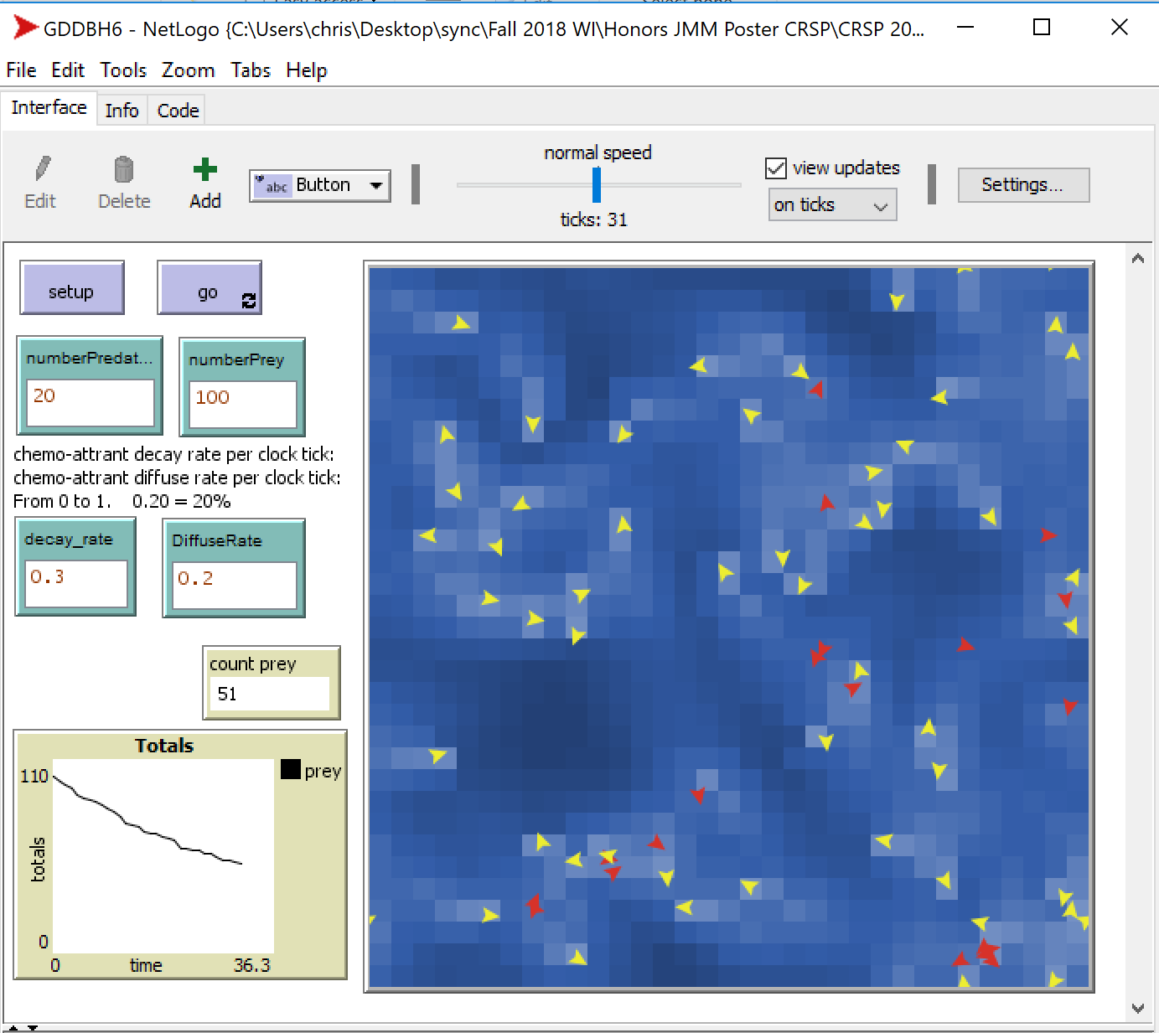
Sources for Virtual
Experiments
NetLogo
Simulation &
Programming
Environment
NetLogo is Free
Virtual Experiments Chris McCarthy cmccarthy@bmcc.cuny.edu

Slide 13
Sources for
Virtual
Experiments
NetLogo
Simulation &
Programming
Environment
Chemotaxis Sim
McCarthy & Watts (2019)
Predators (red) find their prey (yellow) via chemoattractants (blue).
Virtual Experiments Chris McCarthy cmccarthy@bmcc.cuny.edu

Slide 14
Long term goals
To have virtual experiments for each topic in "the" diff eq syllabus
To put these experiments\modeling scenarios online as an Open Educational Resource (OER) in a nicely organized fashion
I am very happy ☺ to share, collaborate, and borrow.
And, to involve students in the production.
Virtual Experiments Chris McCarthy cmccarthy@bmcc.cuny.edu

Slide 15
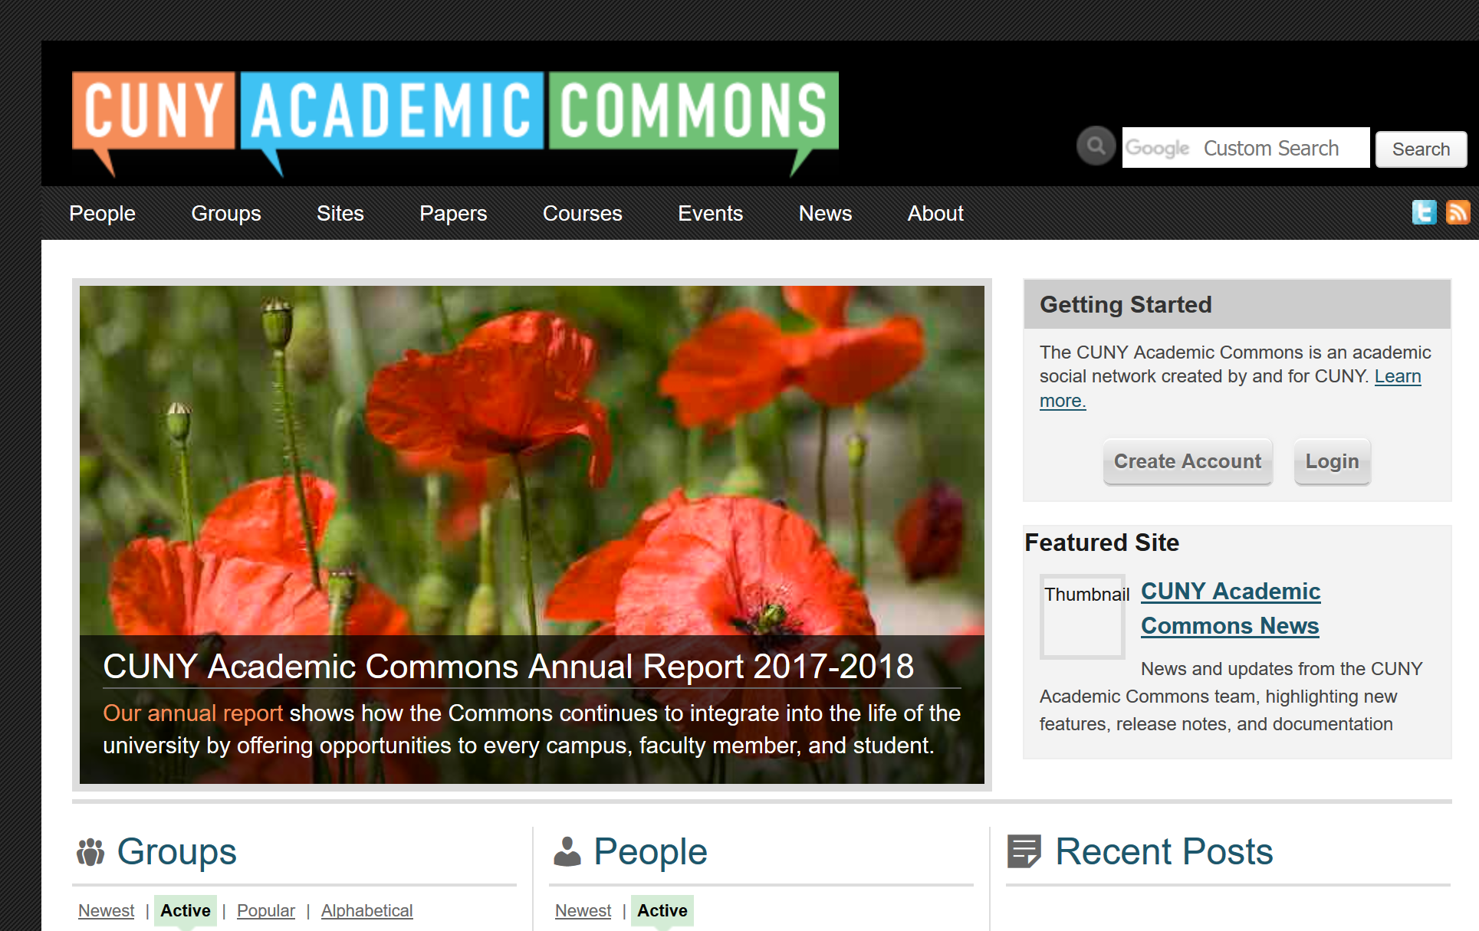
Now I will discuss one of my virtual experiments.
It is on Newton's Law of Cooling.
It is hosted on the CUNY Academic Commons
CUNY faculty can create Wordpress based pages for free on the "Commons".
Virtual Experiments Chris McCarthy cmccarthy@bmcc.cuny.edu

Slide 16
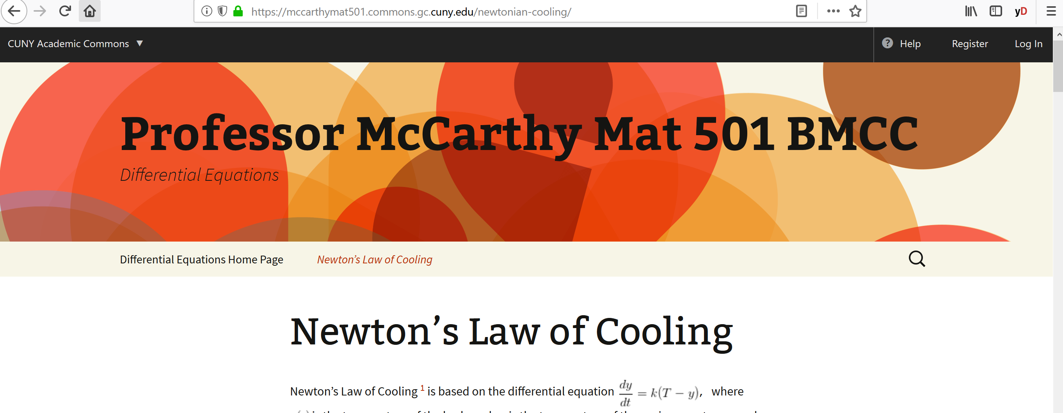
Here is its webpage…
ONLINE https://mccarthymat501.commons.gc.cuny.edu/newtonian-cooling/
Virtual Experiments Chris McCarthy cmccarthy@bmcc.cuny.edu

Slide 17
Virtual Experiments Chris McCarthy (video by Marvin Villalba 2018) cmccrthy@bmcc.cuny.edu

Slide 18
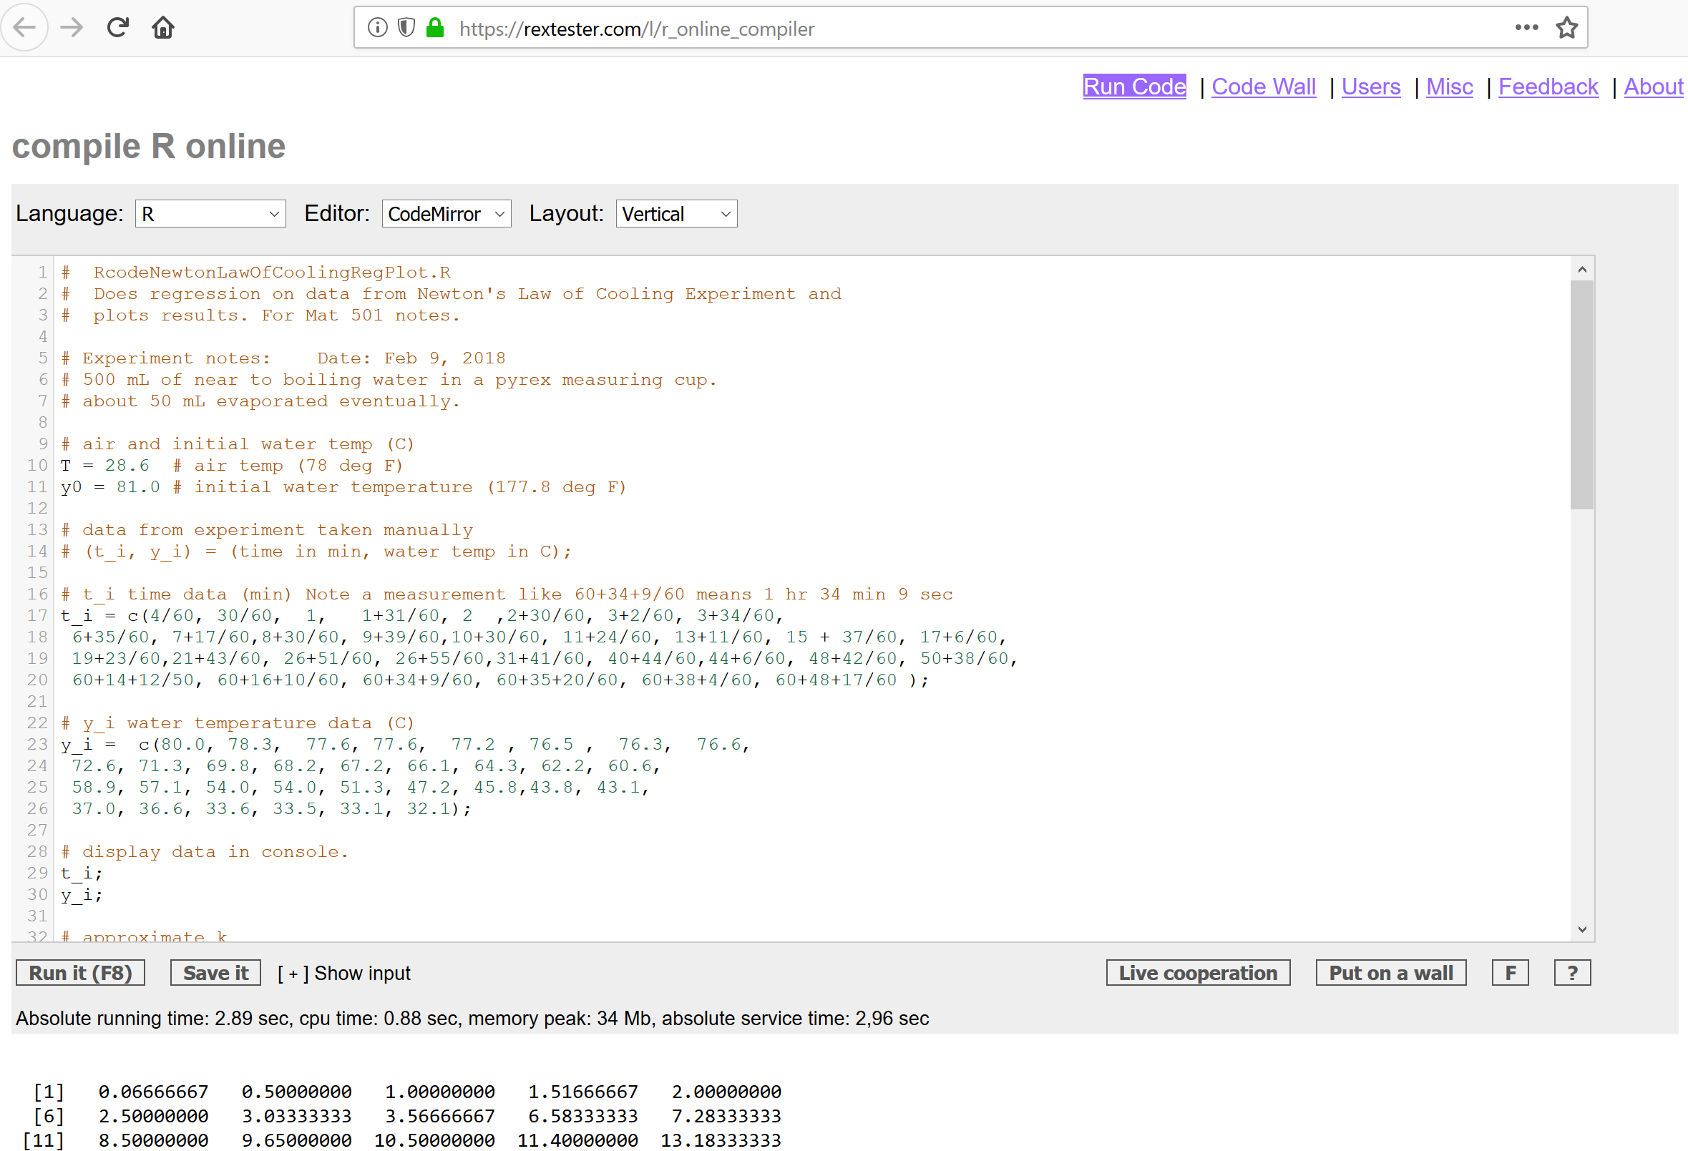
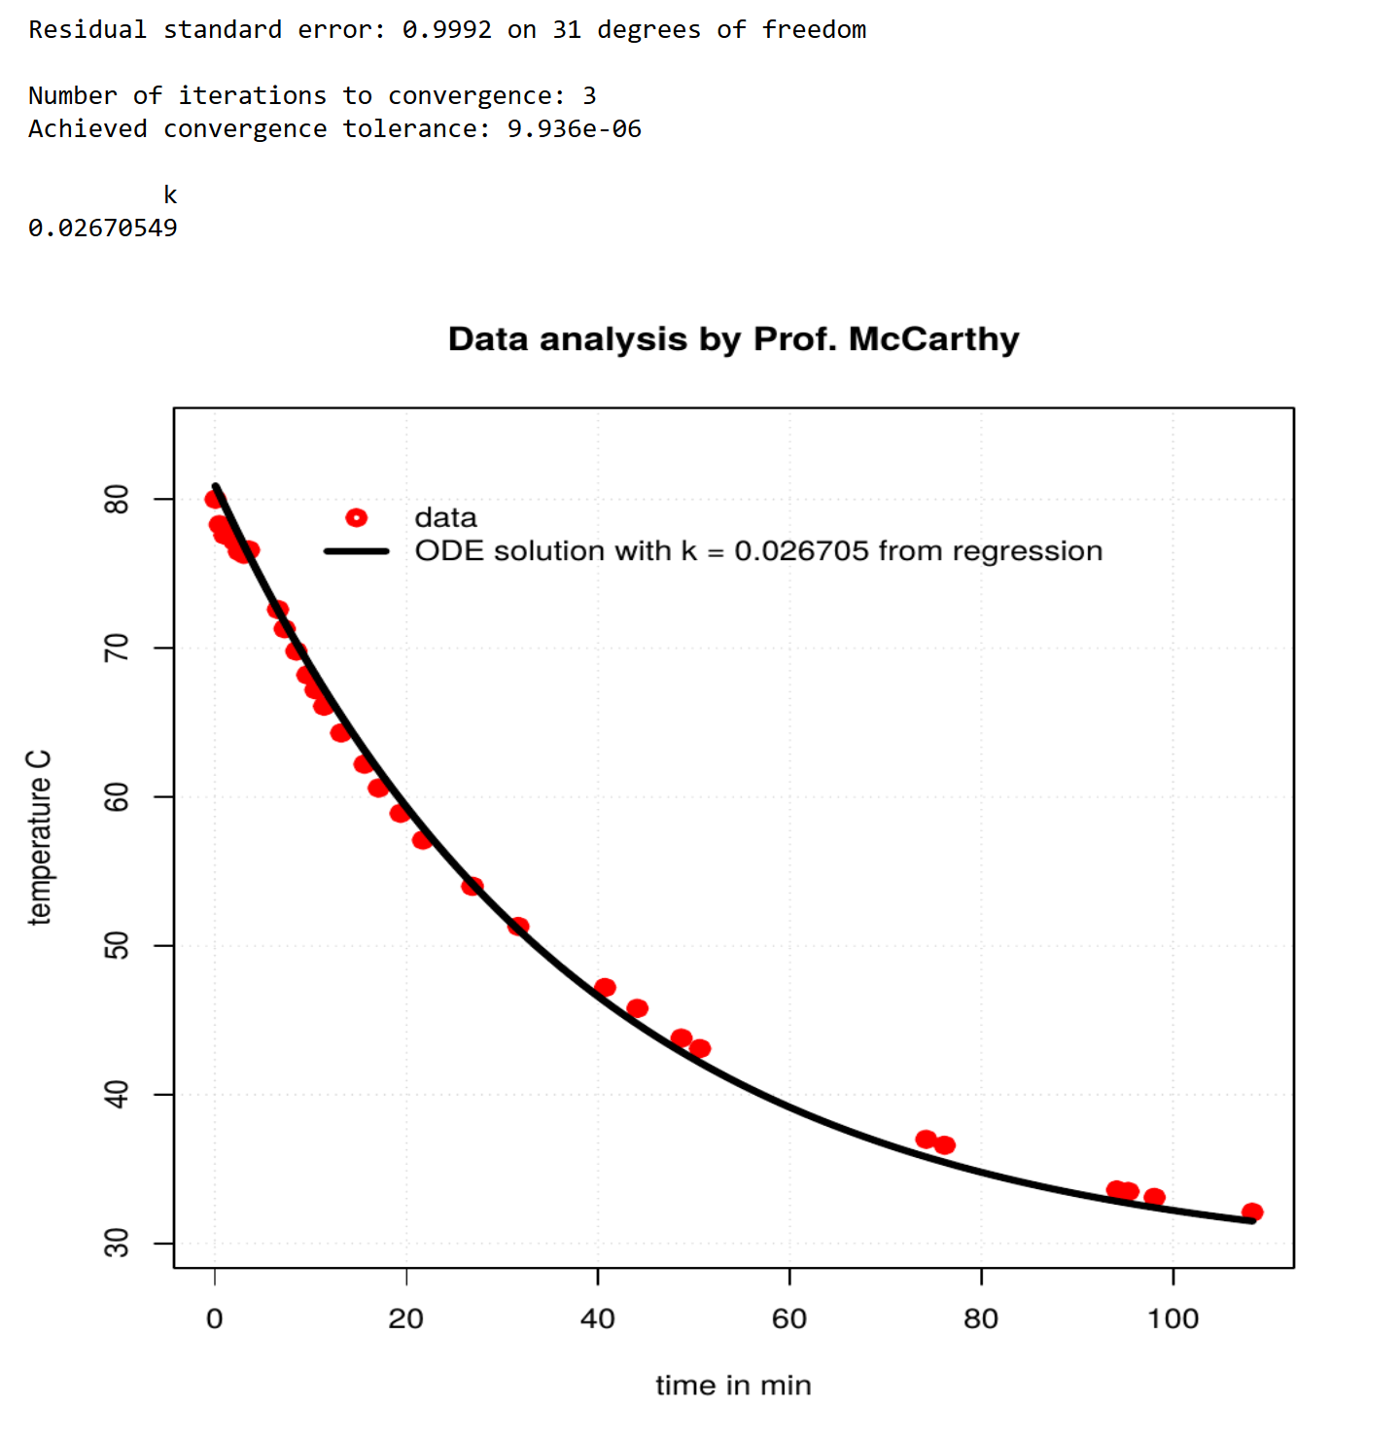
Students copy and modify the R script. They run it on online (RexTester.com) or on their computer.
R is open source!
Virtual Experiments Chris McCarthy cmccarthy@bmcc.cuny.edu

Slide 19
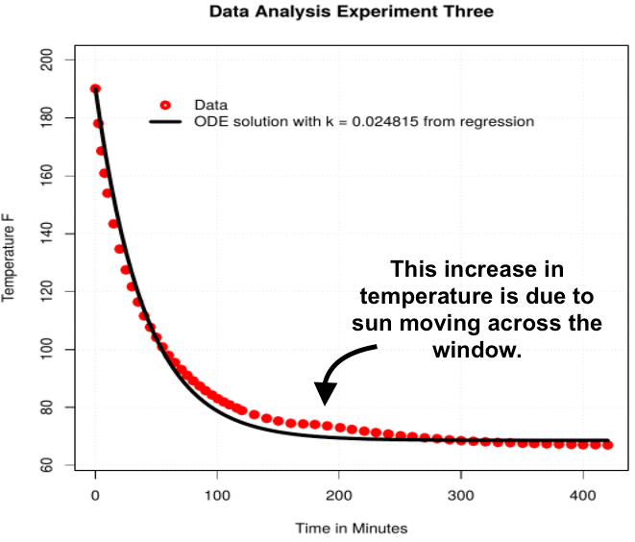
Open ended modeling question for students
Modify Newton's model to account for the varying room temperature.
Virtual Experiments Chris McCarthy (Data/Graph: Marvin Villalba 2018) cmccarthy@bmcc.cuny.edu

Slide 20
Thank You! Please contact me for more information.
Funding Acknowledgements:
NYS OER Scale Up Initiative & CUNY
CUNY (City University of New York) was awarded $4,000,000 from New York State to establish, sustain, and enhance new and ongoing OER initiatives throughout CUNY (FY 2018). The expected result will be large-scale course conversions throughout the university.
BMCC Librarian Professor Jean Amaral
OER Warrior Extraordinaire
Virtual Experiments Chris McCarthy cmccarthy@bmcc.cuny.edu

